Slide 1

The need for Data Analysis
Madrid, Octubre 2021
Python for Data Analysis

Slide 2

Data Science area and profiles
Intro to the current picture of the bursting of data
Digital profiles in the industry
How far data analysis may bring us
DATA ANALYSIS FOR PYTHON

Slide 3
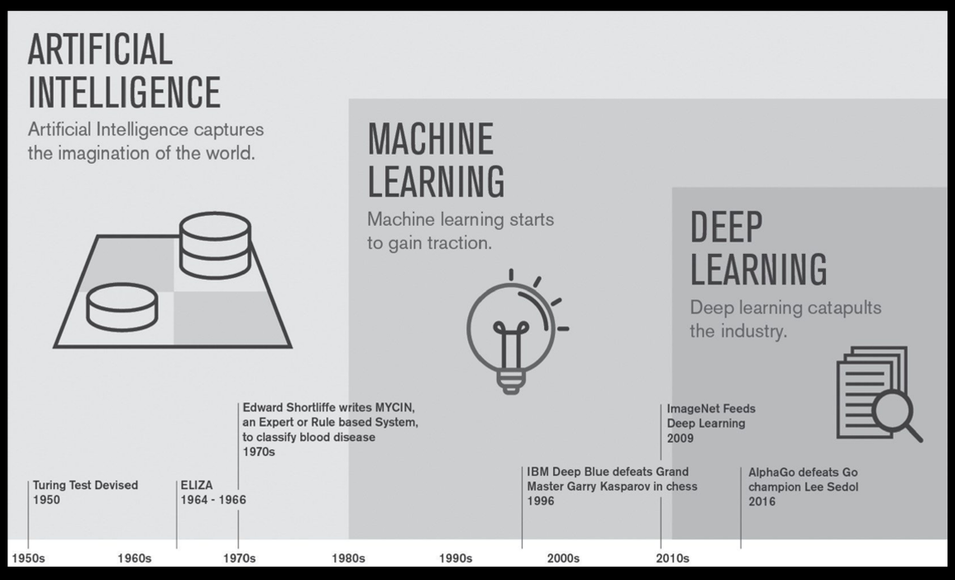
AI - ML - DL
Python for Data Analysis

Slide 4
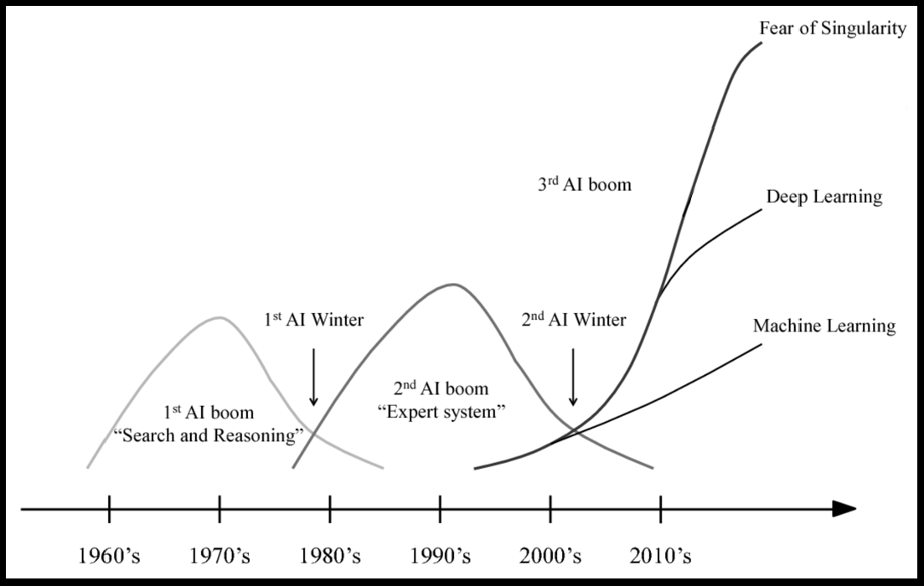
Intro to the current picture of the bursting of data
Python for Data Analysis

Slide 5
Previously on This is data… What happened in 2007?
Apple presents the 1st Iphone to the world
Hadoop makes Big Data possible (from a Google paper)
GitHub appears (to let technical teams work together in the same project with different versions)
Change.org appears as well
Twitter begins to scale up!
Facebook begins to scale up!
Google presents Android
AirBnB posted its first house for renting
Python for Data Analysis

Slide 6
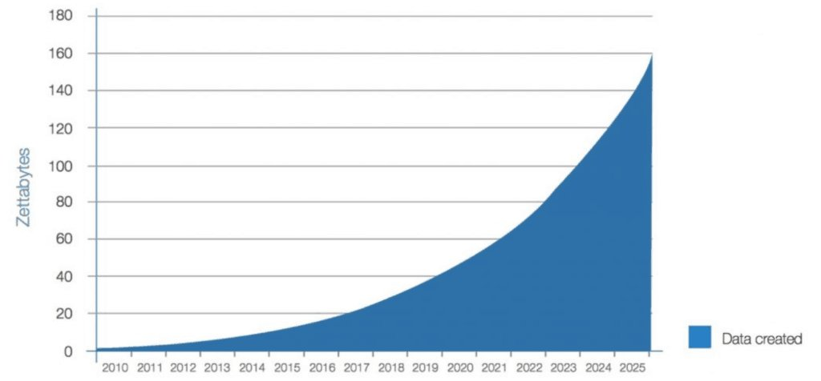
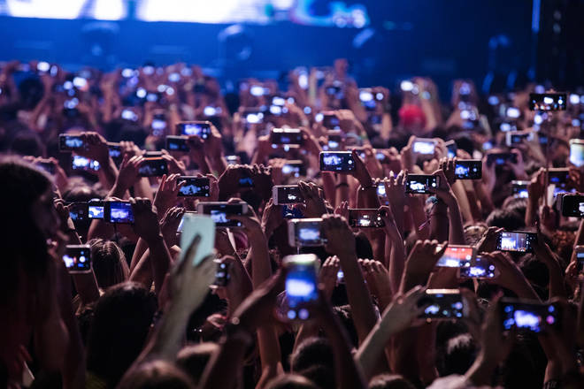
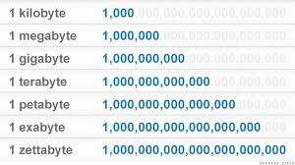
And from 2007 forwards…
Python for Data Analysis

Slide 7
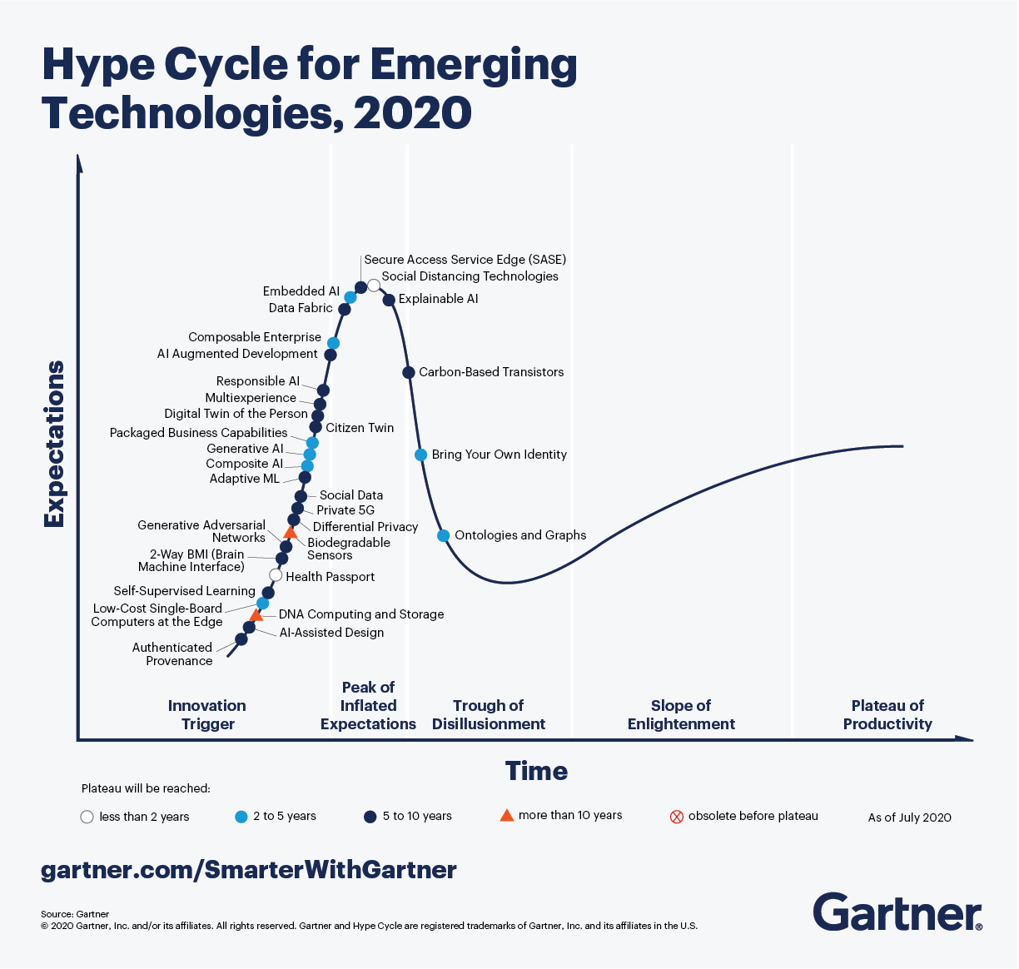
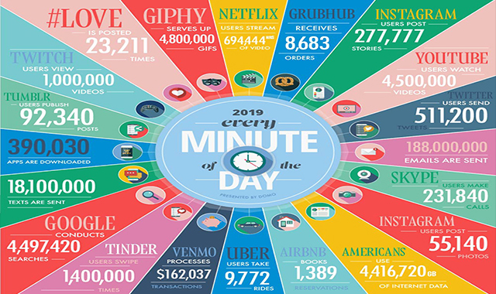
Current trends
Python for Data Analysis

Slide 8
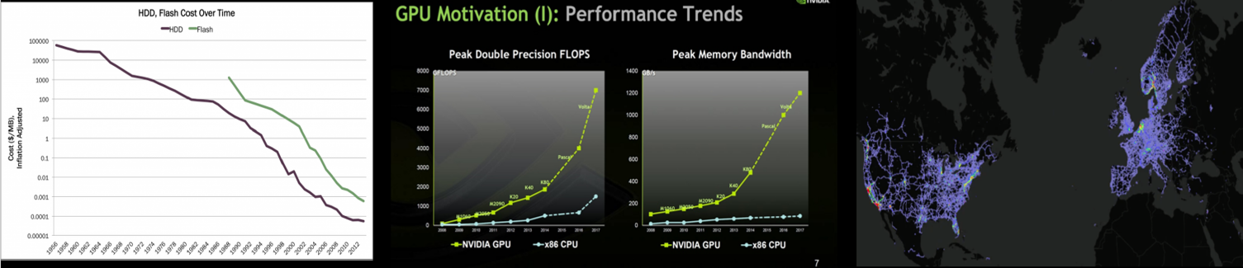
Loading data is cheaper and cheaper
Silicon Valley is named after the silicon, which comes from the sand. There is sand everywhere, it is what the chips are made of and it is extremely cheap!
Python for Data Analysis

Slide 9
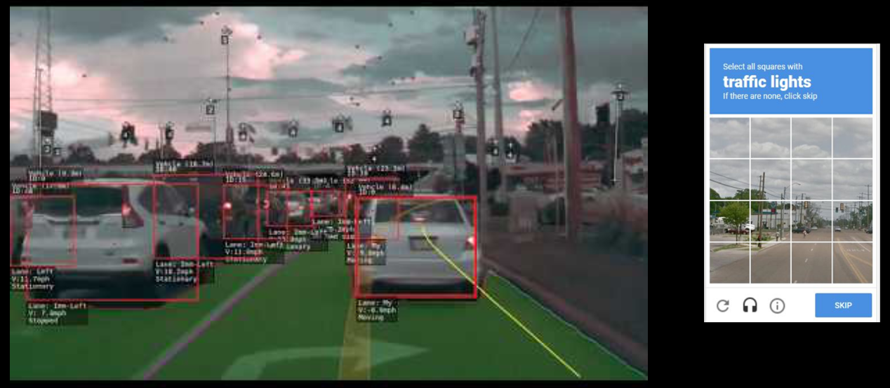
I do not work for free…or do I?
You tought ML algorithms to recognise objects. Thank you!
Python for Data Analysis

Slide 10
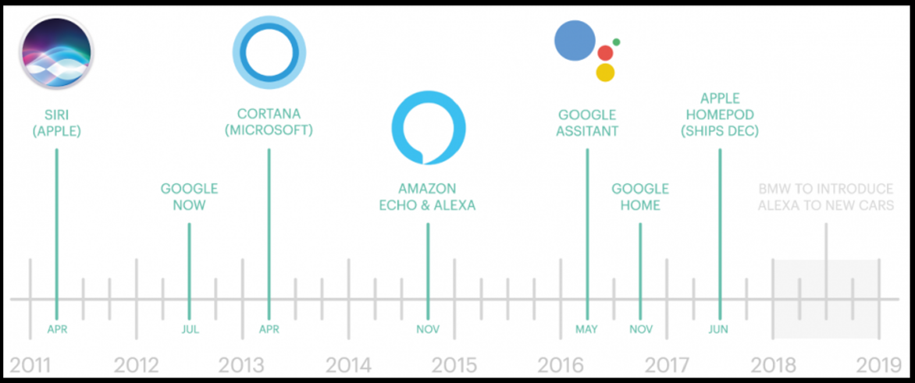
AI is coming home!
Python for Data Analysis

Slide 11
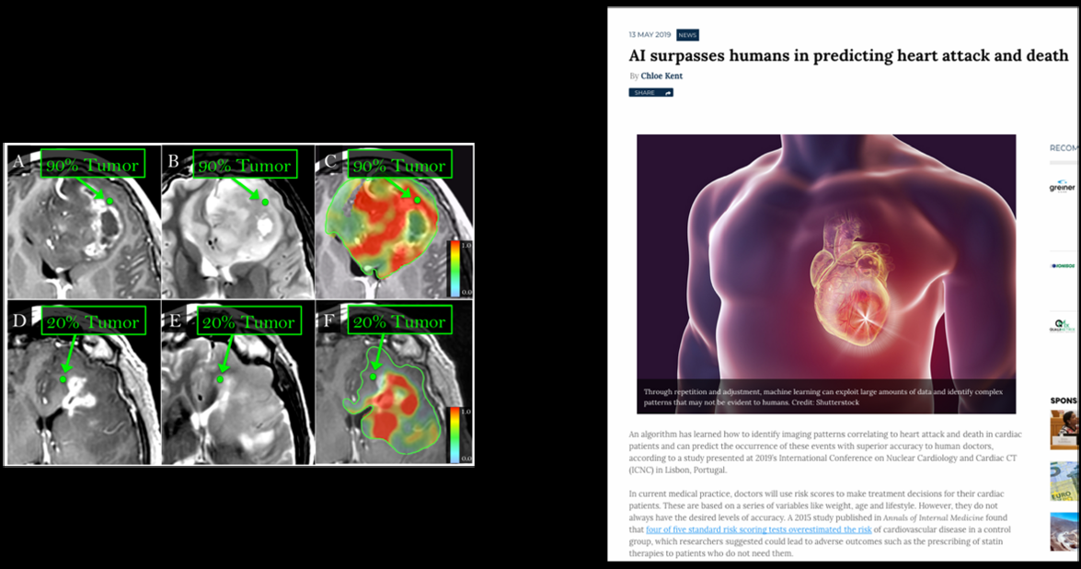
When AI can work better than humans
Python for Data Analysis

Slide 12
Profiles in Data Areas
Data Architecture: Which systems? Dessign of the HW & SW
Data Analysis: They speak the language of business and technical staff
Data Science: They transform data into information (value)
Data Engineering: ETLs (extract, transform and load data)
Data Visualization: Mapping output for business reports
Data Governance: Uniqueness of the data, validation of sources, permissions
DevOps: Putting everything in Production, deploying in real scenarios
Data Security: Defending our data
Python for Data Analysis

Slide 13
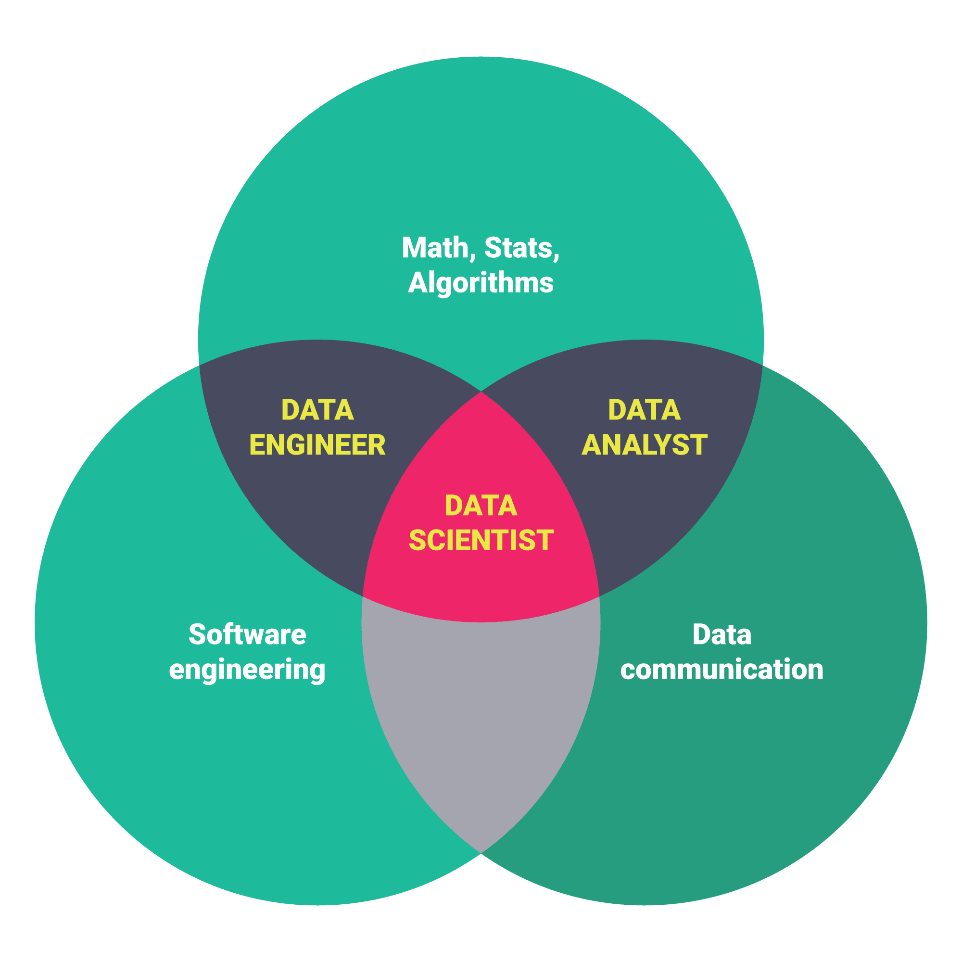
Data Skills
Python for Data Analysis

Slide 14
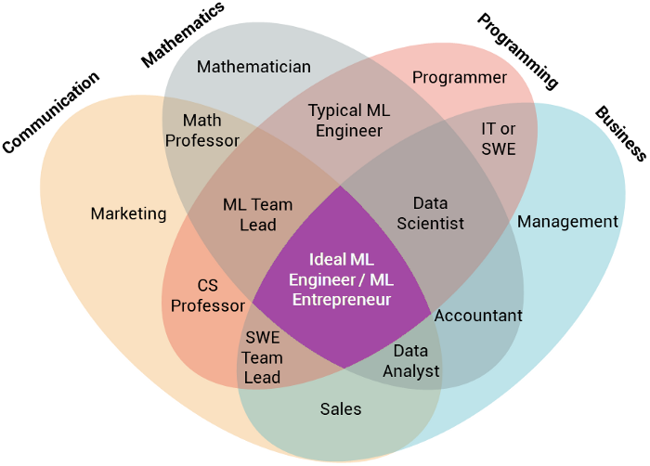
Data Skills in detail
Python for Data Analysis

Slide 15
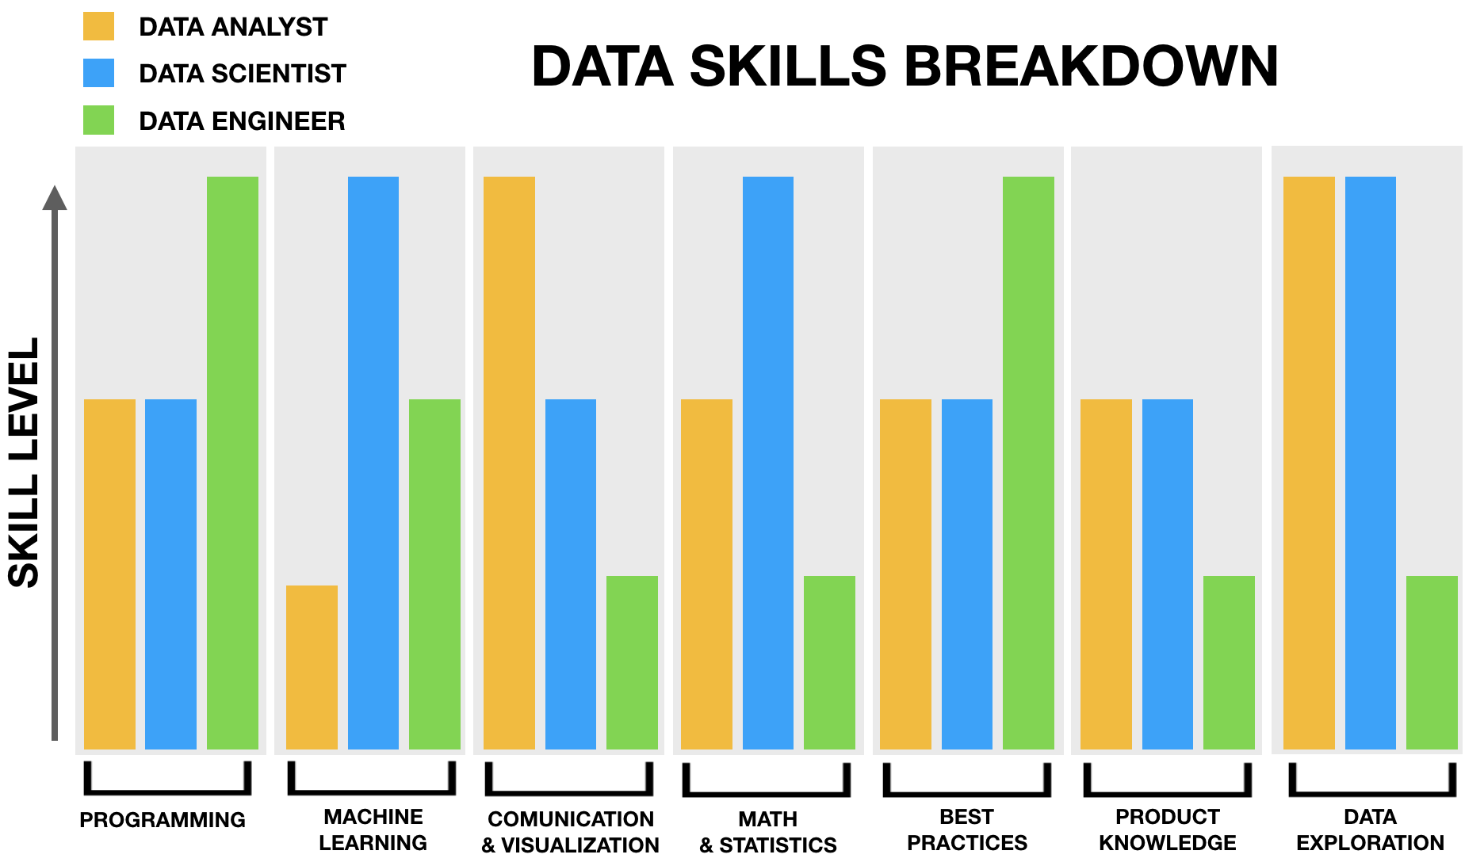
Summing up the skills
Python for Data Analysis

Slide 16
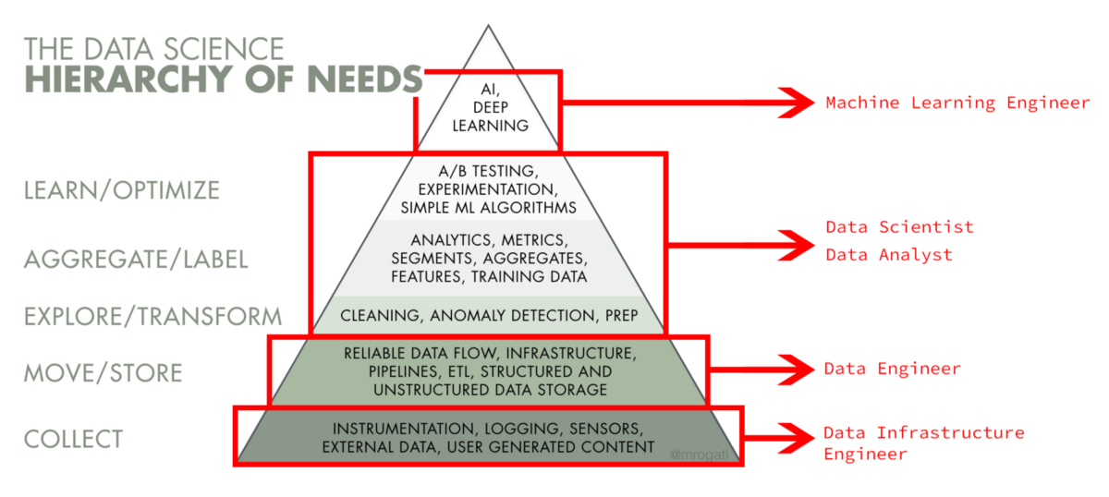
Intro to the current picture of the bursting of data
Python for Data Analysis

Slide 17
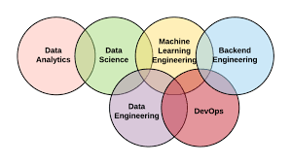
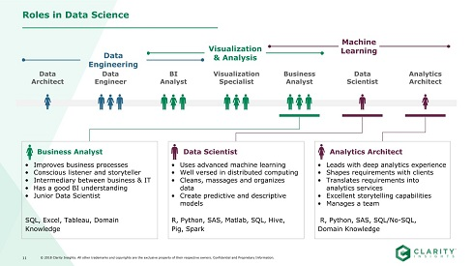
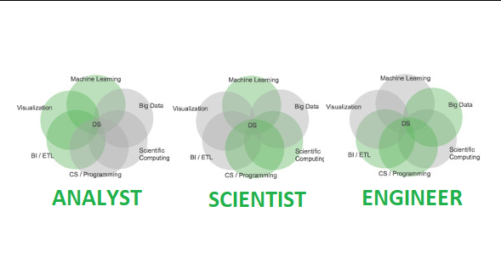
Data Security
Data Governance
Arch
DE
DA
DS
DevOps
Testing Environment
PreProduction Environment
Production Environment
Python for Data Analysis

Slide 18
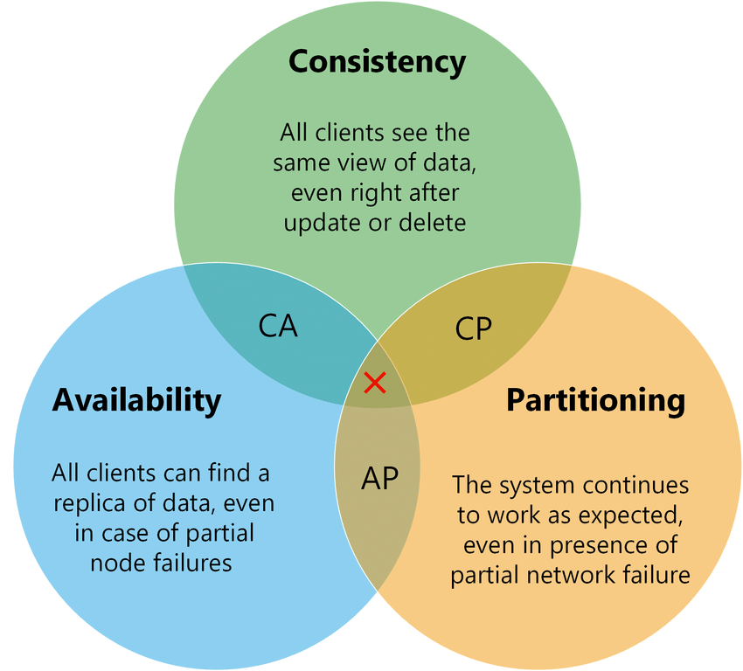
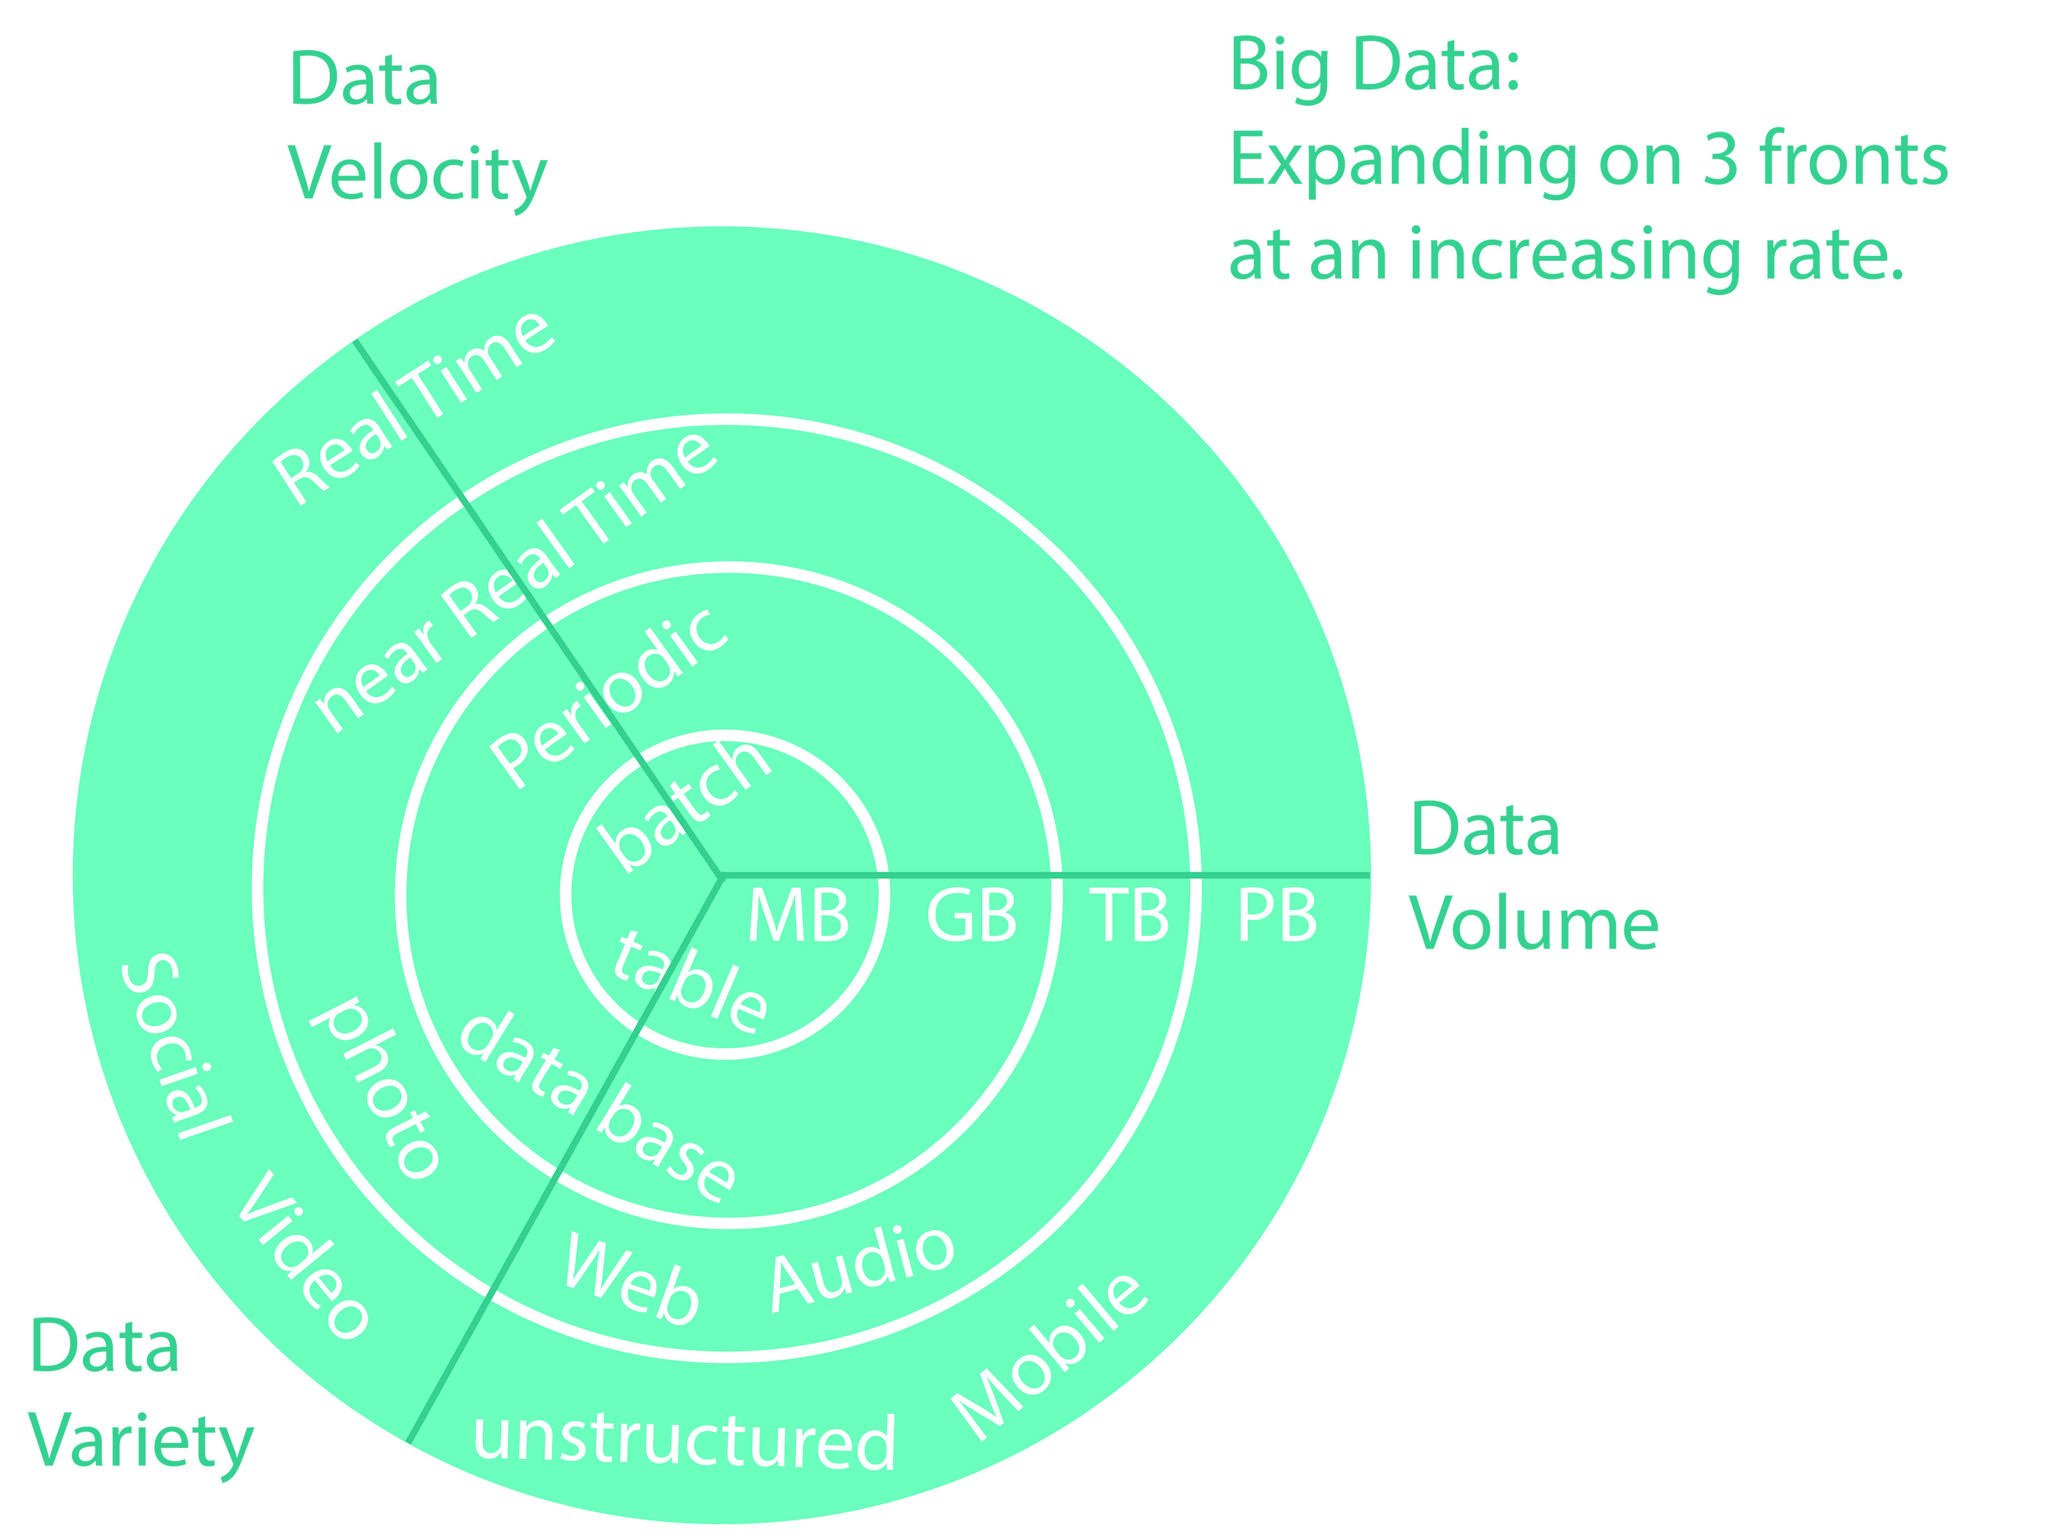
The 3 Vs of Big Data CAP Theorem
Pick 2, Leave 1
IMPOSSIBLE to pick 3
Python for Data Analysis

Slide 19
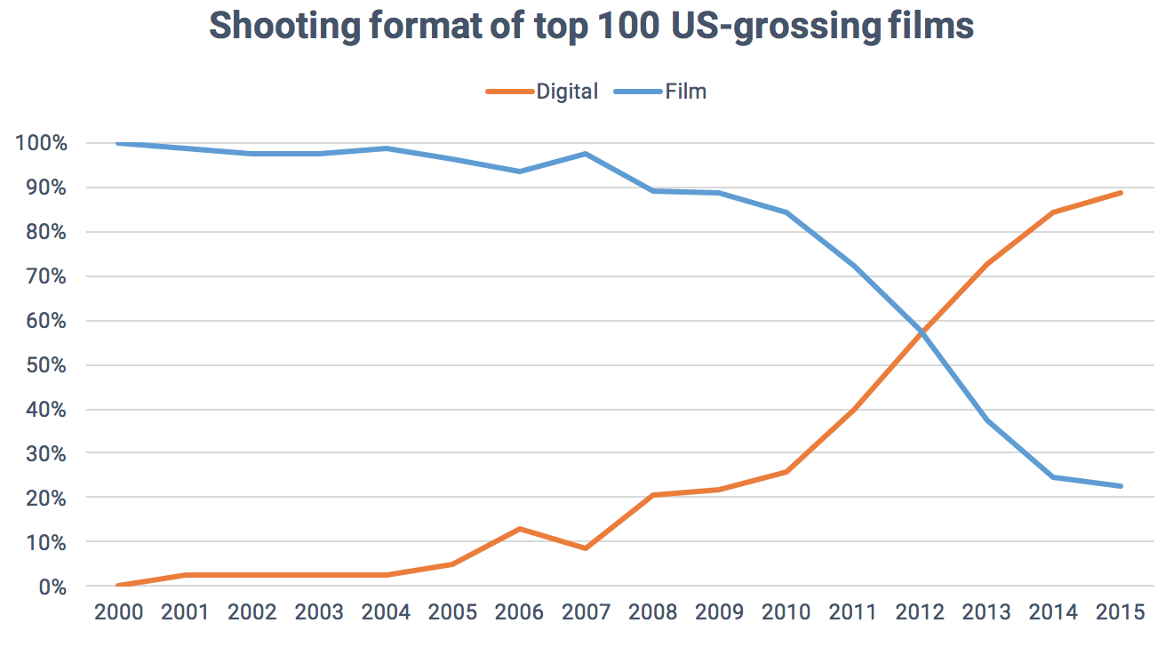

The beauty of data: story telling
CTRL + CLICK on the image for a bit of magic
Python for Data Analysis

Slide 20

OK, so…how far will data take me?
You might think that the filming example is stunning but that traditional data processing can show less impressive results and also work as well.
However, the state-of-the-art in Data Science really needs all the skills that we have discussed. Take a look.
One picture is real and one picture was created from scratch with AI. The fake picture does not exist or is a mix of pictures. An algorithm plotted the face pixel by pixel after learning what a possible human face is.
Python for Data Analysis

Slide 21

The first face has never existed.
Python for Data Analysis

Slide 22
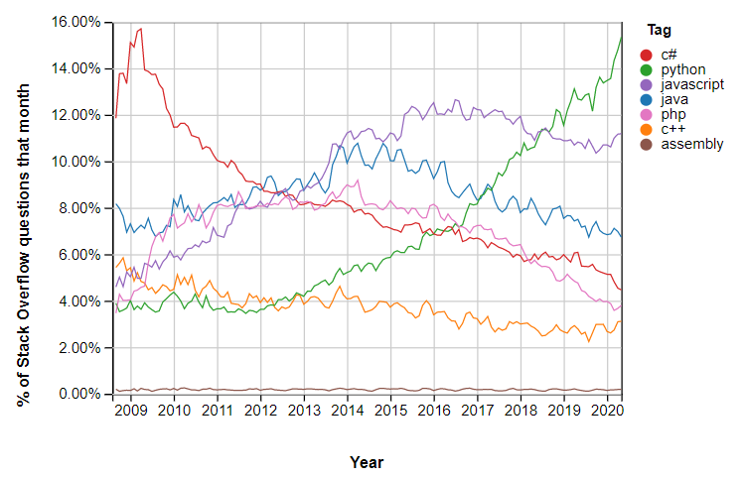
OK, I want to educate myself to become more digital. You should speak Python!
Python for Data Analysis

Slide 23
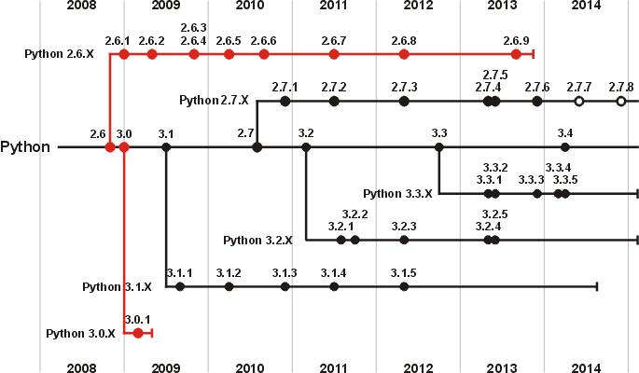
Versions of Python
Family 2.x
Python has 2 versions
Version 2.x and 3.x
They are different ‘families’
Version 2.x IS NOT under 3.x
Families with parallel lives
2.x does NOT work in 3.x
We will learn 3.x
Syntax and commands
are different!
Family 3.x
Python for Data Analysis

Slide 24
Any question?
Thank you!
Python for Data Analysis

